Slide 1
High speed thermography
Janice Dulieu-Barton
Notes:
Please use the dd month yyyy format for the date for example 11 January 2008. The main title can be one or two lines long.

Slide 2
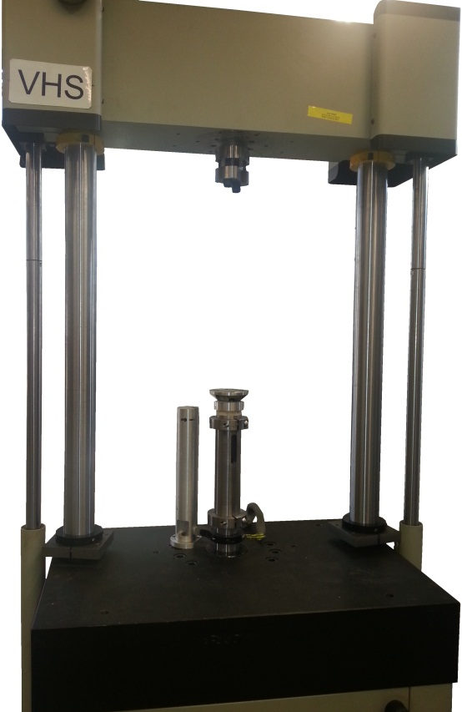
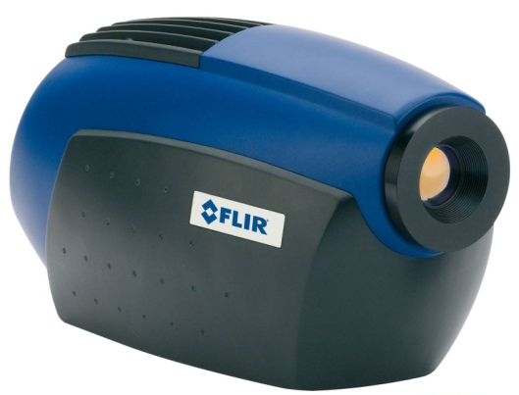
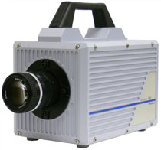
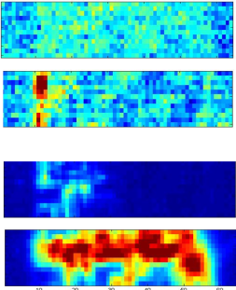
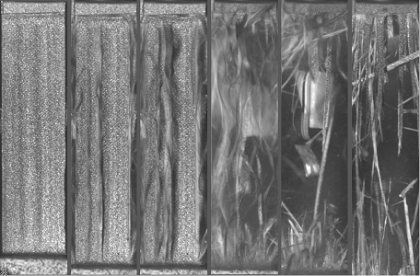
Synchronised DIC + IRT
Infra-red
thermography (IRT)
Digital Image
correlation (DIC)
Trigger
Trigger
Load
Material Characterisation
Thermal
Strain

Slide 3
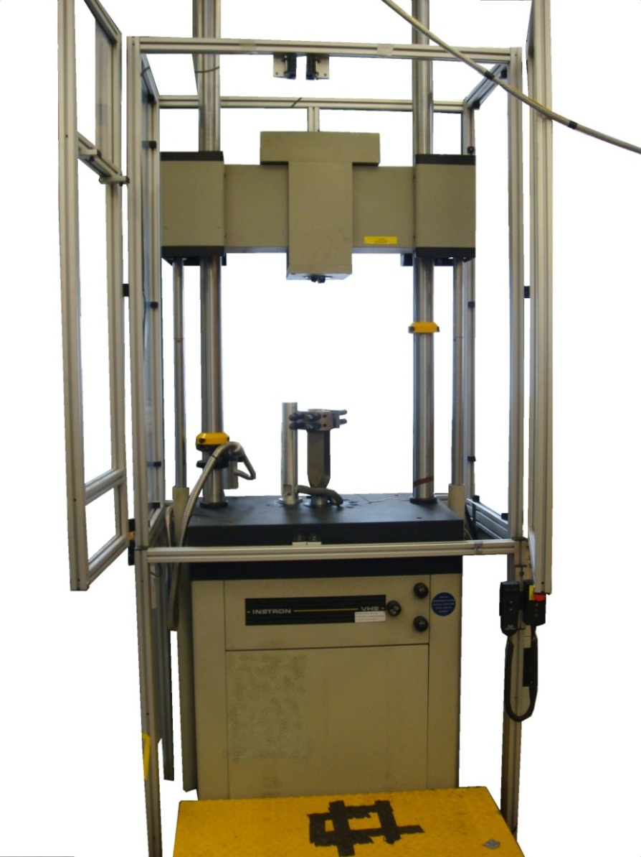
VHS test machine
Technique | Strain rate (s⁻¹)
Conventional Machine Falling Weight Servo-hydraulic Charpy pendulum Split Hopkinson bar Expanding ring Flayer plate, ballistic impact | ≤ 0.1 ≤ 10 0.1 → 100 ≤100 100 → 10⁴ 10⁴ ≥ 10⁵

Slide 4
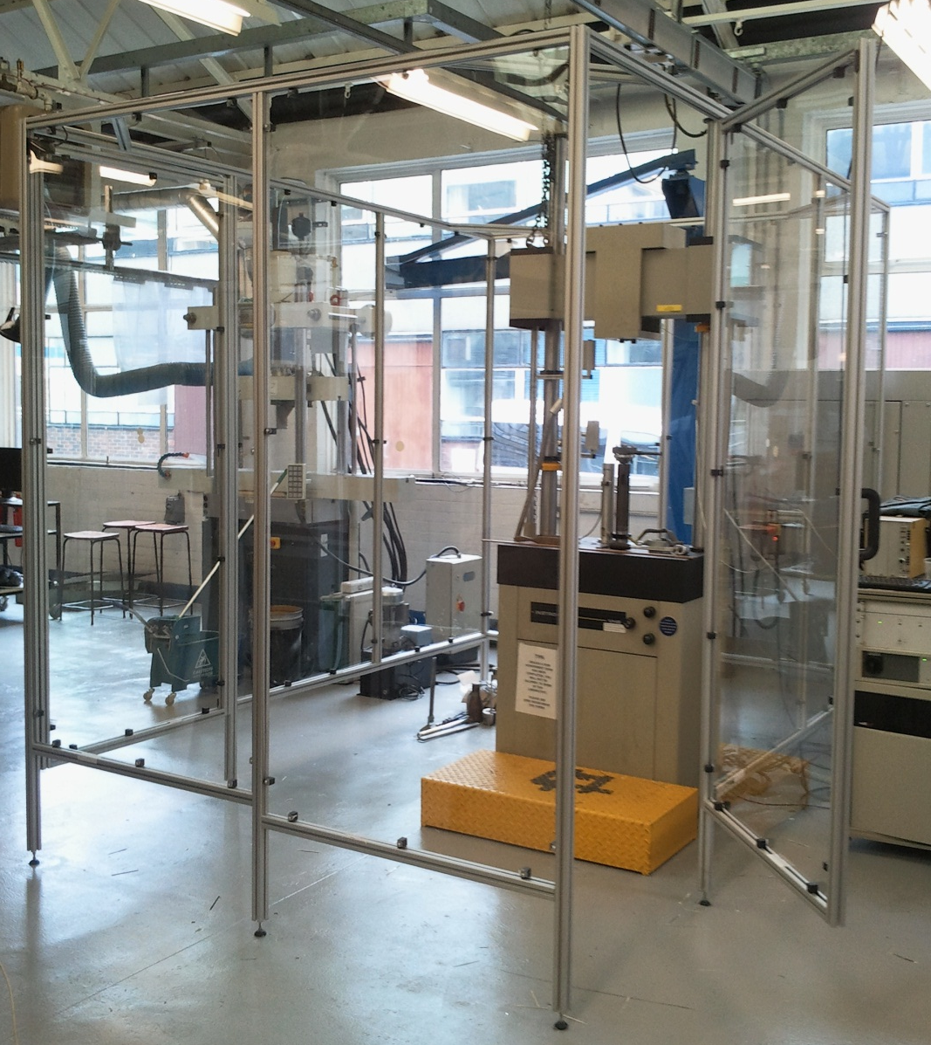
Enclosure

Slide 5
Camera and lighting
Speckled Specimen
VHS
Instron
Light
source
Light
source
High speed
camera
IR
detector

Slide 6
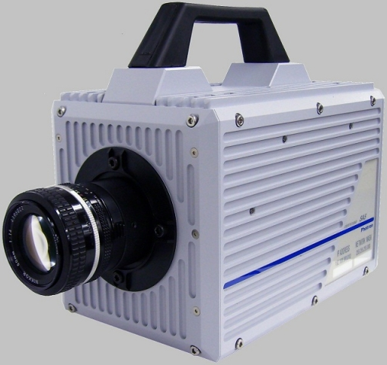
Photron SA5 HS camera
Model: Photron SA 5 Monochrome high speed camera
Sensor: 12-bit ADC (Bayer system colour, single sensor) with 20 µm
Memory: 8GB, 5,457 frames @ maximum resolution
Max Resolution: 1024 x 1024
7000 fps at max resolution
1000000 fps at 64 x 16
Triggering: Selectable positive or negative TTL 5V or switch closure

Slide 7
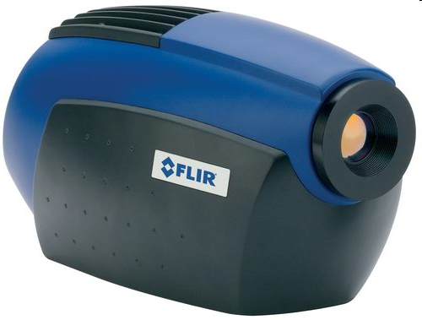
Detector specification
Model:
  Cedip Silver 480 M
  (now the FLIR SC5000)
Array:
  320 x 256 elements
  30 μm pitch
  ½” chip (12.3 mm diagonal)
  Indium Antimonide (InSb)
  3-5 μm wavelength band
Standard operational range:
  278 to 583 K
  maximum frame rate: 383 Hz (at full frame)
  sensitivity 4.12 mK / DL (at 298 to 299 K)
  (electronic noise ~17 mK)

Slide 8
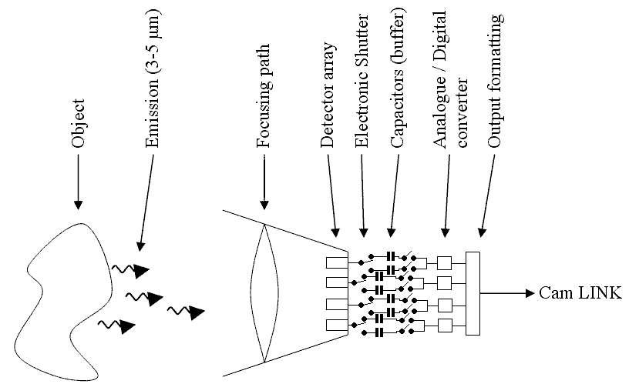
Detector operation

Slide 9
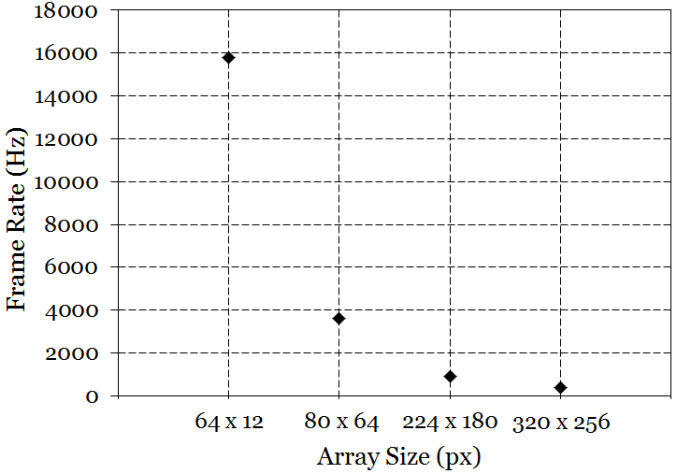
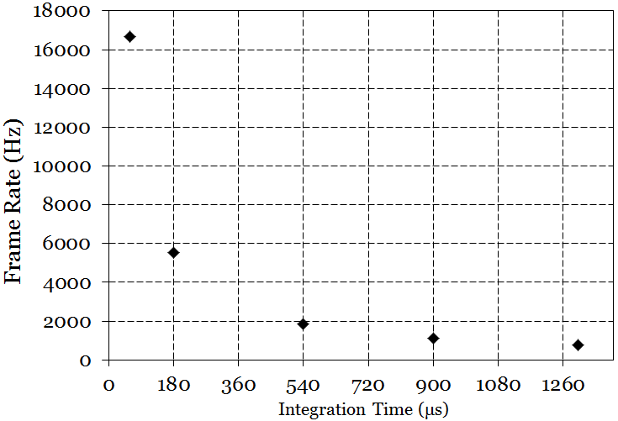
Acquisition frequency
Spatial resolution (i.e. frame size / data transfer rate)
Thermal resolution (i.e. integration time)
Influence of Window Size
Influence of Integration Time

Slide 10
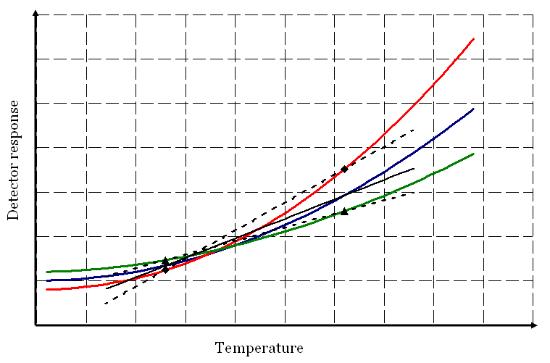
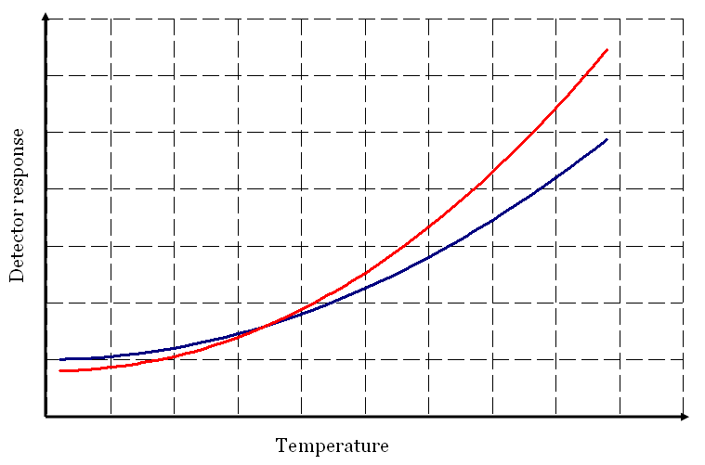
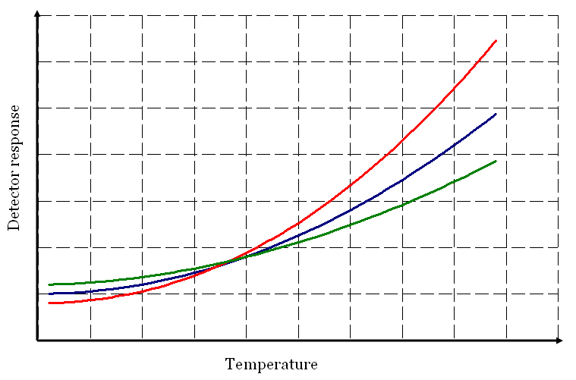
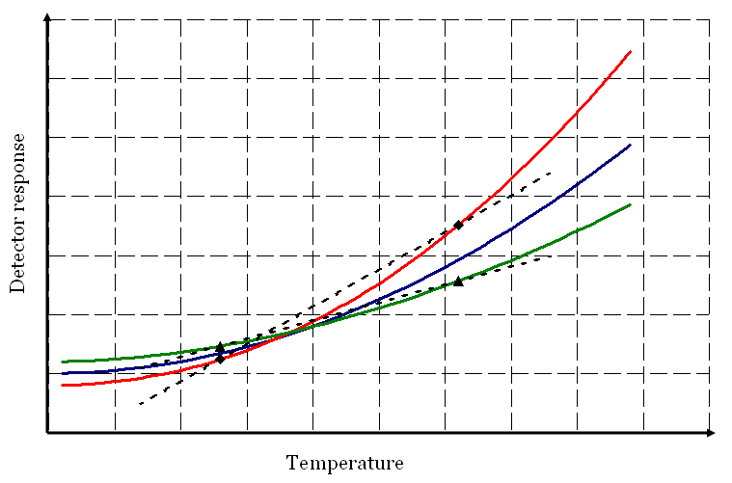
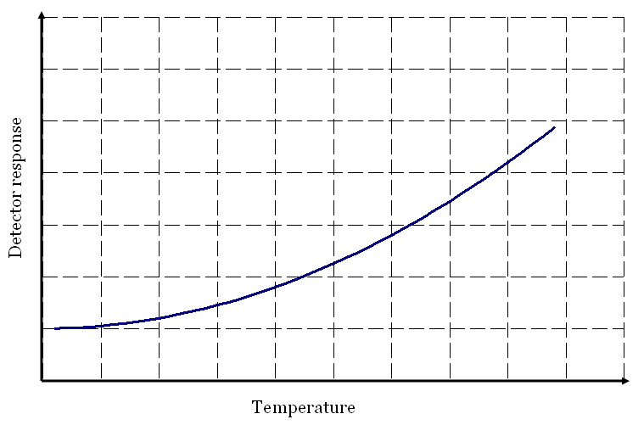

Non-uniformity correction (NUC)
To compensate for variation in sensitivity across the detector:
  sensitivity of the detector elements
  efficiency of the capacitor in the read-out circuit
30 %
70 %

Slide 11
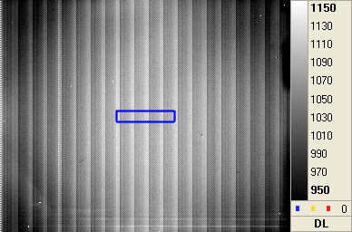

Detector response

Slide 12
Characterisation process
Raw data
(Images from black body)
Black body temperature
(thermocouple)
DL T
…
DL T
…
DL T
…
DL T
…
DL T
…
DL T
…
DL T
…
Notes:
12

Slide 13
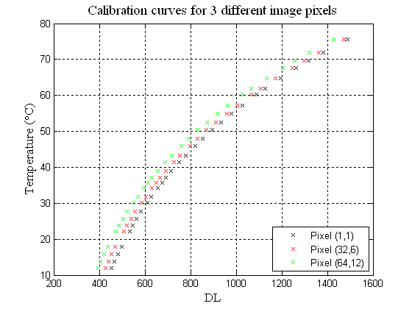
Calibration curves

Slide 14
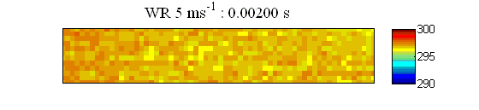
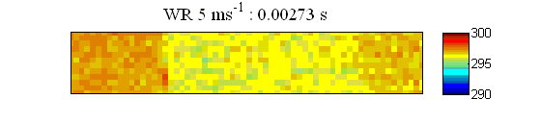
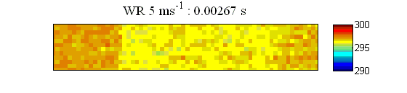
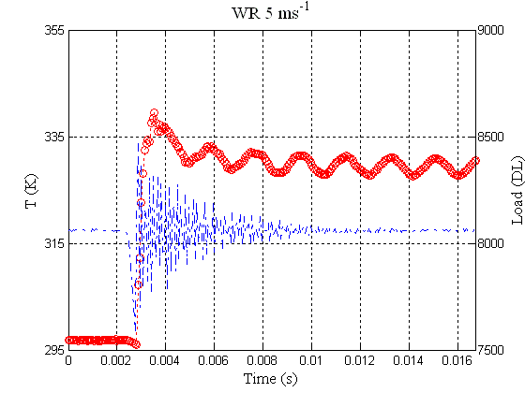
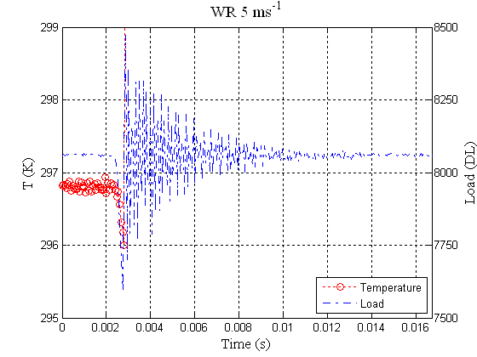
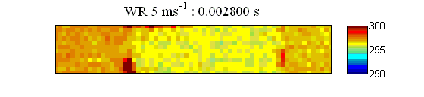
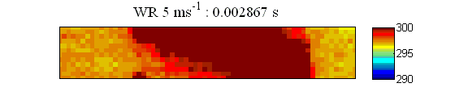

Sample data from a high speed test
Loading rate: 5 ms⁻¹
Frame rate: 15000 Hz
IT: 60 μs
Window size: 64 x 12 pixels

Slide 15


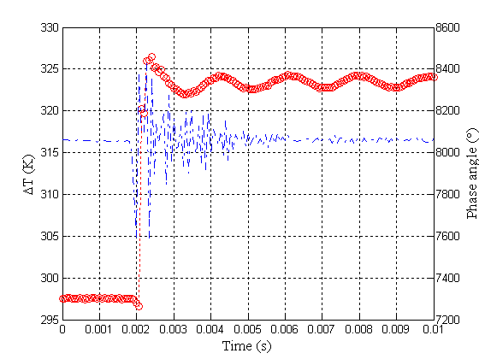

Sample data from a high speed test
Loading rate: 10 ms⁻¹
Frame rate: 15000 Hz
IT: 60 μs
Window size: 64 x 12 pixels
Fruehmann, R.K., Crump, D.A. and Dulieu-Barton, J.M., “Characterization of an infrared detector for high frame rate thermography”, Meas. Sci. Technol. 2013, 24,105403 (12pp). DOI 10.1088/0957-0233/24/10/105403

Slide 16
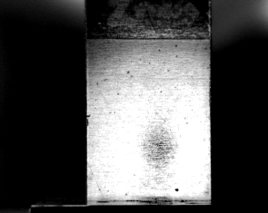
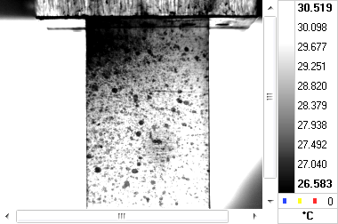
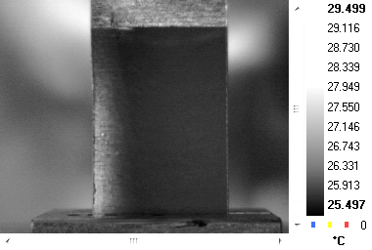
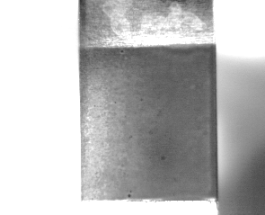
IRT through painted pattern
Matt white only Matt white with black speckle
Matt black only Matt black with white speckle

Slide 17
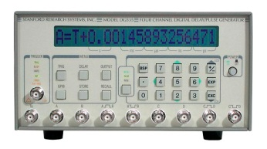

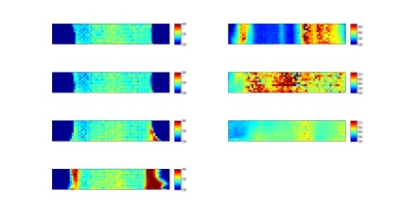

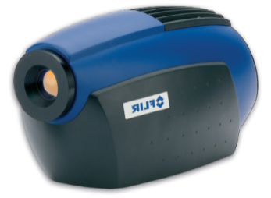




Accurate system triggering
Pulse generator
Trigger signal
Trigger signal
Actuator displacement
Infra-red
detector
Trigger
VHS
contr.
Data
High speed
camera
Trigger
VHS
Instron
Data
Load
Control signal

Slide 18
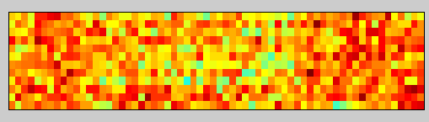
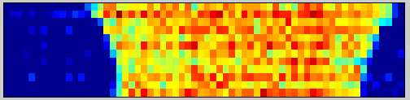


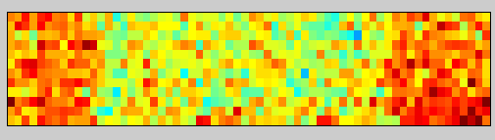

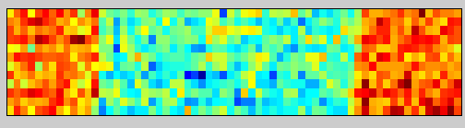

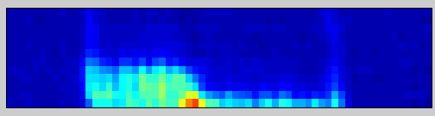


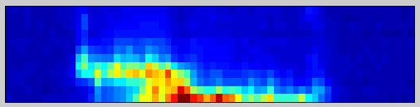
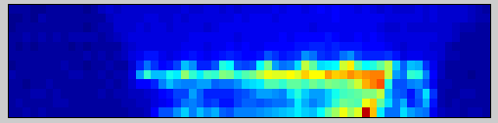
IRT with paint and lights
0.40
0.53
Time
(ms)
0.00
0.13
0.26
No paint, no lights
Paint and lights
(K)
(K)
(K)
(K)

Slide 19
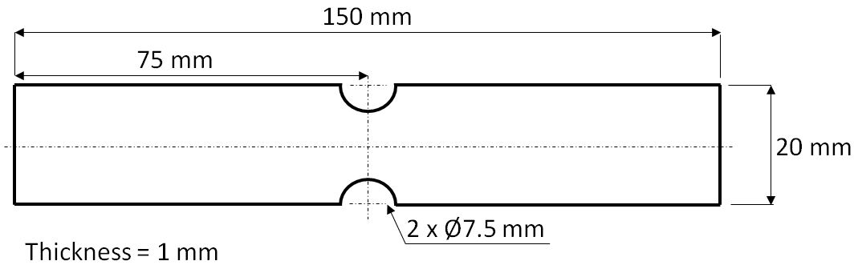
GFRP in tension
Material | 0.001 m/s | 1 m/s | 10 m/s
GFRP CP 0 | x | x | x
GFRP CP 90° | x | x | x
GFRP woven | x | x | x
Providing material characterisation of a range of materials over a range of strain rates!

Slide 20
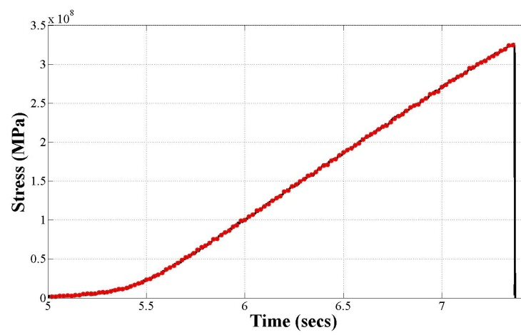
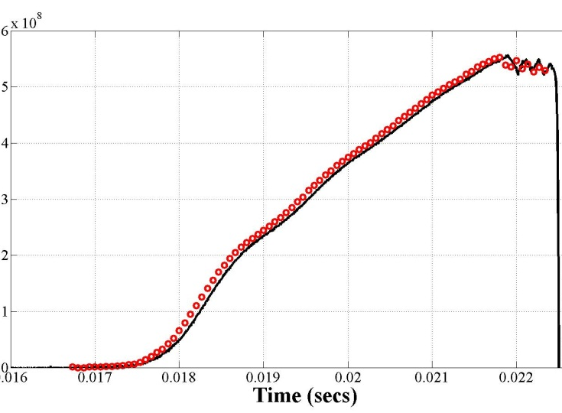
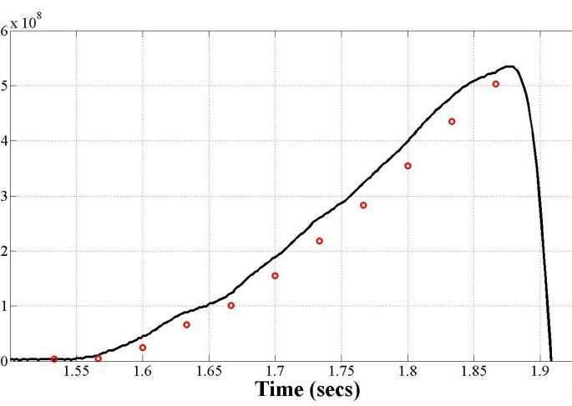
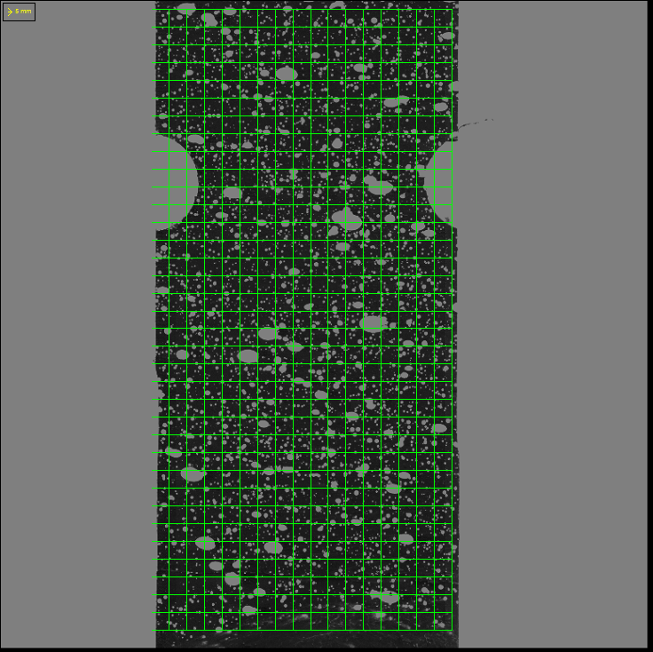
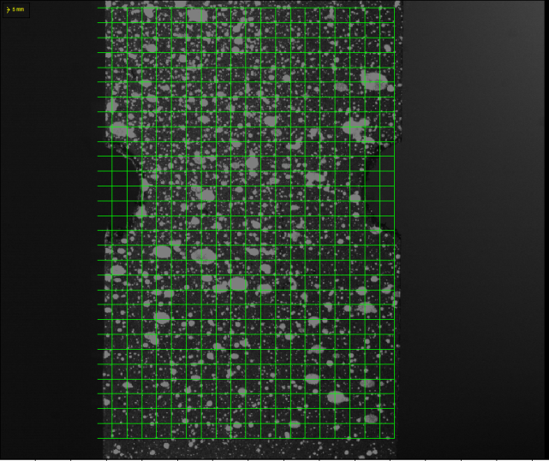
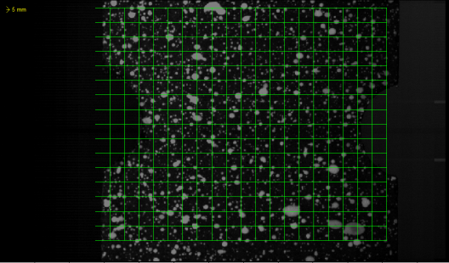
GFRP in tension
Experimental setup
0.001 m/s
@ 50 Hz
1 m/s
@ 15000 Hz
10 m/s
@ 30000 Hz

Slide 21
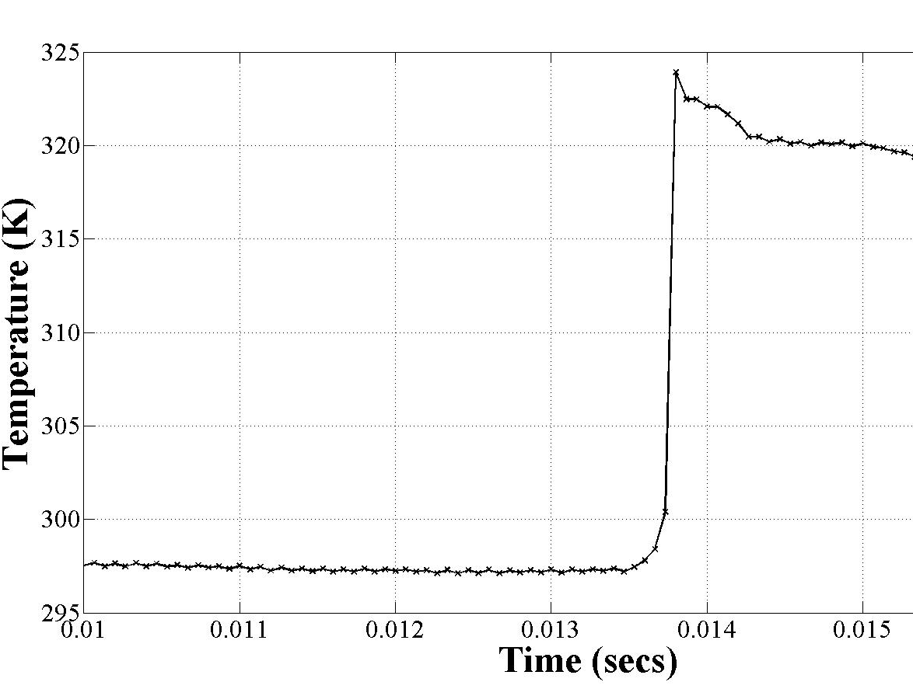
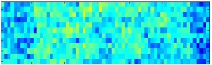









GFRP in tension
4
2
3
3
1
2
1
(K)
%
1
300
3.0
2
296
1.5
350
3
1
2
3
4
0.0
4
296

Slide 22

GFRP in tension
Effect of strain rate

Slide 23

GFRP in tension
Effect of strain rate

Slide 24
High speed IR thermography
Highest achievable frame rate is 15 kHz
Can we capture temperature evolutions at higher rates
Can we use this idea anywhere else?
Estimating fracture toughness
Wang. W, Dulieu-Barton, J.M., and Thomsen, O.T., “A methodology for characterizing the interfacial fracture toughness of sandwich structures using high speed infrared thermography”, Experimental Mechanics, 56, 2016, 121-132. DOI: 10.1007/s11340-015-0023-3

Slide 25


Determination of fracture toughness
theoretical derivation
Fracture in solids is a dissipative process and heat is released during the fracture.
Upper
surface
Lower
surface
25
1. Weichert.R, Schonert. K. Heat generation at the tip of a moving crack, J Mech Phys Solids 1978, ; 26:151-161.

Slide 26

Determination of fracture toughness
theoretical derivation
Fracture in solids is a dissipative process and heat is released during the fracture.
Fracture toughness can be formulated by combining the above equations.
Fracture occurs in
brittle material
26

Slide 27

Determination of fracture toughness
experimental arrangements
Temperature measurement
IR detector: FLIR SC5500
  Array size: 320×256 pixels
  Maximum frame rate: 383 Hz
High speed IR thermography (>1000 Hz)
  New calibration process (nonlinear behaviour) ¹
  Frame rate: 15kHz (12×64 pixels)
  Noise threshold ~0.3 ⁰C
Crack advance measurement
High speed camera: Photron SA-3
  Frame rate: 5 kHz
Experimental arrangements:
Data acquisition equipment (NI USB-6211)
Cameras in pre-trigger mode
Load collected by IR detector system
27
Notes:
Notes: To validate the proposed linear relationship, we use the test setup as shown here for obtaining the ΔT_{S} /ΔA value. The infrared is used to capture the temperature change across the crack front and the high speed camera is used to monitor the crack advance. To capture the temperature increase values before the heat dissipates, here we applied the high speed infrared thermography with a frame rate of 15 kHz.

Slide 28



Test specimens
The sandwich specimen studied in this work comprised a PVC H100 foam and E-glass/epoxy composite face sheets.
25 mm
15 mm
Mode I
(Opening)
Mode II
(Shearing)
Varied crack tip mode-mixity
  Core material thickness
  Lever arm distance (c)
28

Slide 29

Temperature and load trace
Average temperature taken across the crack
front the corresponding load trace
29
Notes:
For all the plots, the temperature images before crack growth and after crack growth are plotted. The temperature image before crack growth was the average values obtained from 100 images before the crack growth.
The ΔT image is obtained by subtracting the two temperature images before and after crack growth.
In the plot, a is the crack length, c is the lever arm length, b is the specimen width and P is the critical load.

Slide 30


Results
Specimens with crack kinking into the foam
Specimens with crack growing at the interface
30
Notes:
So after this, we can plot the temperature increase at the crack surfaces per unit area against the fracture toughness. For different crack propagation path, we can clearly see the linear relationship which verifies the proposed methodology. This means by determining the slope of the straight line for different materials, the fracture toughness can be derived from a direct temperature measurement

